Slide 1
EECS 498 System Design of a Search Engine
Winter 2026
Lecture 25: Review and reflections
Nicole Hamilton
https://web.eecs.umich.edu/~nham/
nham@umich.edu

Slide 2
agenda
details
final exam review
reflections
commencement address

Slide 3
agenda
details
final exam review
reflections
commencement address

Slide 4
remaining schedule
Today: Review for the final
Thu April 17, Fri April 18, Tue April 21: Presentations
Tues Apr 21: Peer evals, final reports and project archive due
Wed April 22 through Wed April 29: Team debriefs
Wed April 29 4:00pm: Optional final exam, Dow 1013 and 1206.

Slide 5
details
Fill out your column of the search engine comparison spreadsheet at https://tinyurl.com/W26SearchEngines

Slide 6
presentation order
Thursday April 16
Section 005 12:00 to 1:20
*ClosedAI
*Cache Me If You Can
Section -012 1:30 to 2:50
The Avengineers
The Ranking Hat
Friday April 17
Section -012 1:30 to 3:20
Seamus the Search Engine
Bing Chilling
*404 Found
Section -005 3:30 to 5:20
Check Engine Light
The Most Most Wanted
*I'm Feeling Lucky
Tuesday April 21
Section 005 12:00 to 1:20
Browser Juniors
OSeans 7
Section -012 1:30 to 2:50
Twoogle
*Crawl Me Maybe?

Slide 7
agenda
details
final exam review
reflections
commencement address

Slide 8
W25 final
Posted to Canvas in the Files > Exams > Midterm folder:
EECS498W25 Final Exam Solution.pdf
Your exam will be similar, 25 TF or MC + 10 short answer.

Slide 9
agenda
details
final exam review
reflections
commencement address

Slide 10
I hope you enjoyed the course and that you may have better outcomes because our lives intersected.

Slide 11
outcomes
The hoped-for outcome was that you learned how to tackle a large system design project on a startup team of 6 o 7.
I wanted your experience to be like what I what I experienced at Microsoft (or at least, the good parts.)
I hope it helped you think about what kind of career you’d like.
I hope it can help you get jobs.

Slide 12
observations
To get really good at anything, takes two things.
You must be able to relentlessly criticize your own work, looking for ways it could be improved.
You need practice.
You can keep getting better all your life.

Slide 13
observations
No one should spend their life in a career they don’t love.
It’s important to take pride in your work.
Your work must provide satisfaction.
We all have intellectual and social needs for purpose.

Slide 14
observations
We began our discussion with an observation that digital electronics had changed the world from the one even your parents experienced.

Slide 15
if you are 20 in 2024
But none of these statements are true for your parents.
TV has never had snow.
You could listen to any song you want anytime you want.
Phones have always had apps.
Cameras have never used film.
You can buy anything online.
Everyone has always had computers.
Music has never has hiss.

Slide 16
what made this possible
Three key technologies made this possible.
Positional numbers
Digital circuits
Microelectronics

Slide 17
what made this possible
Positional number systems, where each position is a power of the base, were invented by the Babylonians, making arithmetic simple.
(Consider the alternative of doing addition in Roman numerals.)
Positional numbers
Digital circuits
Microelectronics

Slide 18
what made this possible
Digital circuits with a noise margin that allows them to give the correct output, even if there’s some noise on the input.
Positional numbers
Digital circuits
Microelectronics

Slide 19
what made this possible
We can now throw billions of digital circuits at a problem.
You can have as many as you like, they take almost no space, and you can power them with a small battery.
Positional numbers
Digital circuits
Microelectronics

Slide 20
But the world is not done changing.

Slide 21
then we talked code
We talked the OS and then about how a search engine works.
You built an HTML parser, programs to read web pages and serve them up, and how to memory map a hash table.

Slide 22
what I did better this time
We got tee shirts. (Yippee!)
I updated a number of autograded assignments before the class started, including Utf8 and Multithreaded file operations.
I finally explained how to do a form plugin to LinuxTinyServer using GET.
I got my robots.txt assignment written.

Slide 23
what I’ll do better next time
(assuming there is one)
I always learn something.
I’d like to update and improve the Bloom filter and expression parser assignments.
I’m thinking of possibly adding a constraint solver assignment.

Slide 24
thank you
I wish you all great success in life and I hope some of what we talked about here will be useful.
Thank you for being my students.

Slide 25
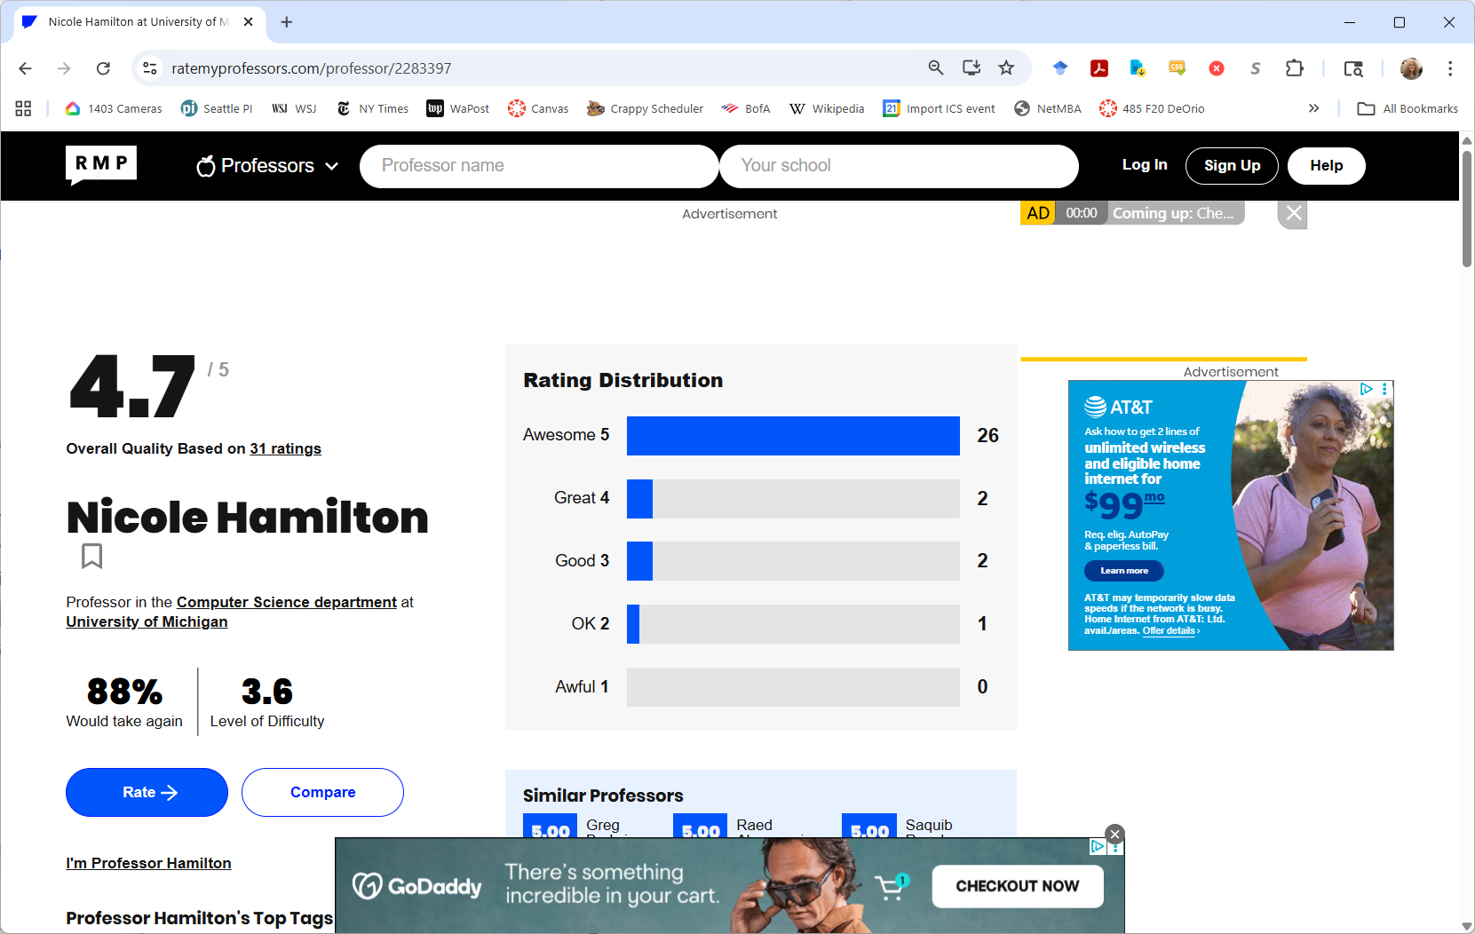
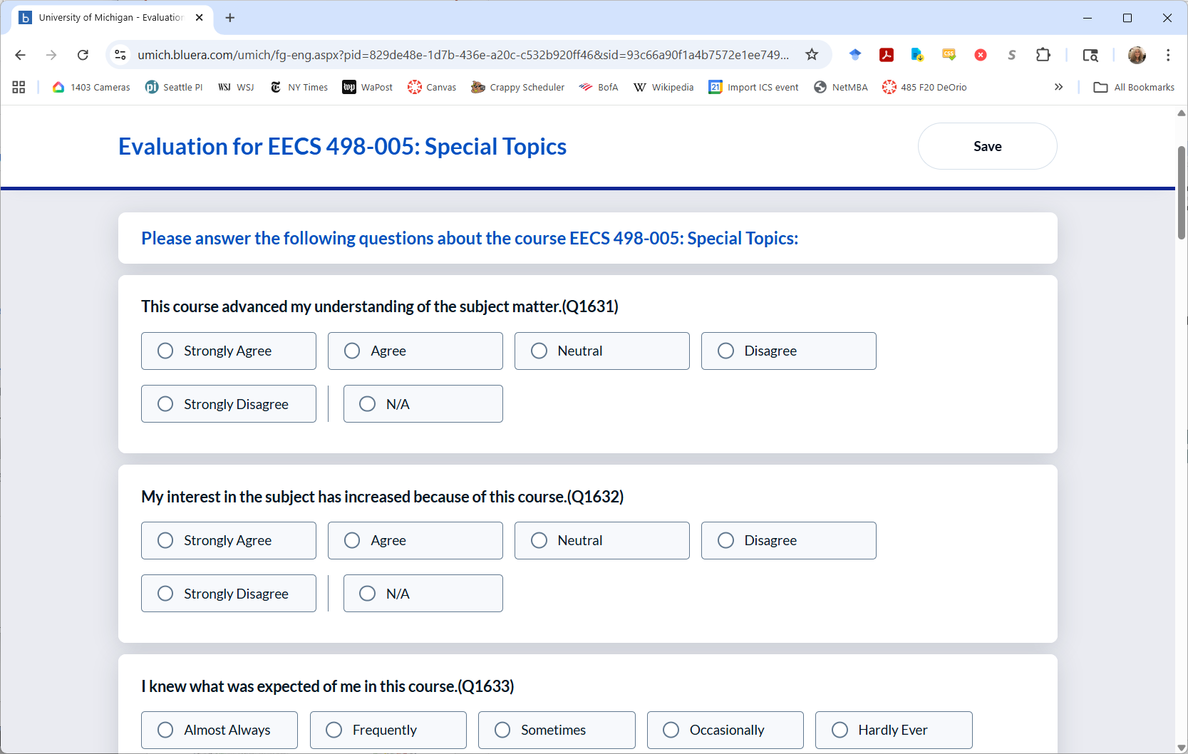
Please take the survey at https://umich.bluera.com/umich/ before April 22.

Slide 26
Maybe say something nice at ratemyprofessors.com.
(But you’ll have to add a 498 class.)

Slide 27
agenda
details
final exam review
reflections
commencement address

Slide 28
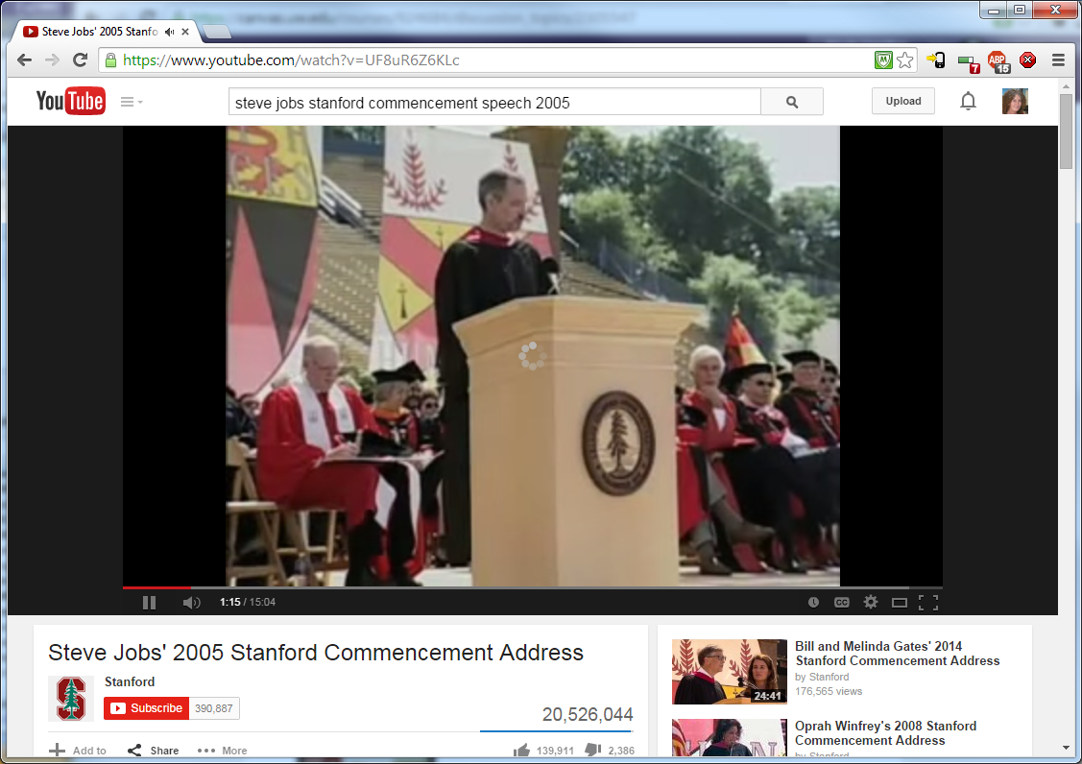
Steve Jobs commencement address at Stanford in 2005.
https://www.youtube.com/watch?v=UF8uR6Z6KLc

